Slide 1















Multilingual Sentiment Analysis
Shubham Ojha
20BCE1205
VIT Chennai
Capstone Project
Guide - Dr. Rajalakshmi R

Slide 2

OUTLINE OF THE PROJECT
Multilingual sentiment analysis poses a significant challenge in natural language processing, particularly in languages with limited resources such as Malayalam. This research addresses the problem of sentiment analysis in Malayalam by comparing various machine learning and deep learning models. Leveraging datasets from the CodaLab Fake News Detection in the Dravidian Languages competition, our study investigates the efficacy of Support Vector Machines (SVM), Random Forest (RF), Logistic Regression, Naive Bayes, and deep learning techniques including BERT classifiers. We apply these models to two distinct datasets: one comprising YouTube comments classified as original or fake, and the other categorizing news into five different categories false, mostly false, true, half true, and mostly true. Our experimentation involves three deep learning approaches: utilizing BERT classifiers directly on the Malayalam text, translating Malayalam to English using the Helsinki-NLP pipeline before employing BERT, and employing an Indic BERT tokenizer for enhanced tokenization. Recognizing the issue of fake news and the influence of social media comments on public opinion, our research seeks to address the challenges of identifying misinformation in online content. Furthermore, we provide comprehensive comparisons using accuracy metrics and confusion matrices, shedding light on the strengths and limitations of each model in the context of Malayalam sentiment analysis. This research contributes to the advancement of sentiment analysis in understudied languages, offering insights into effective modeling techniques and highlighting avenues for future research in multilingual natural language processing, particularly in combating fake news and understanding social media discourse.

Slide 3
INTRODUCTION
Multilingual Sentiment Analysis, specifically in this study, is a computational technique for identifying and categorizing emotions expressed in text across multiple languages, with a focus on the Malayalam language.
This project utilizes machine learning and deep learning algorithms to analyze and distinguish between authentic and counterfeit sentiments in social media posts and comments.
This project stands as a testament to the potential of machine learning in breaking language barriers and enriching our understanding of global digital communications.

Slide 4
Problem Statement
Address the scarcity of sentiment classification models for non-English languages.
Develop a multilingual sentiment analysis framework for the Malayalam language.
Focus on fake news detection and verification of originality in YouTube comments.

Slide 5
Research Objective
Determine the authenticity of YouTube comments through advanced machine learning (ML) algorithms.
Classify news articles in Malayalam into five categories: True, Mostly True, Half True, False, and Mostly False.
Identify and evaluate the most effective ML and DL algorithm for both YouTube comment authenticity and news classification in Malayalam.
Measure and validate the accuracy of the selected ML algorithm using testing data to ensure reliable results.

Slide 6
Proposed System Introduction:
Proposed System Implements models for identifying the originality of Malayalam language YouTube comments and detecting fake news using supervised learning algorithms.
Utilizing deep learning techniques specifically for fake news detection, divided into three distinct parts:
Initially applying the BERT model directly to the Malayalam text for classification.
Translating the Malayalam text to English and then applying the BERT model to the translated text for enhanced understanding and classification.
Employing Indic BERT tokenizer and model specifically designed for Indian languages, including Malayalam, to classify the content more accurately.

Slide 7
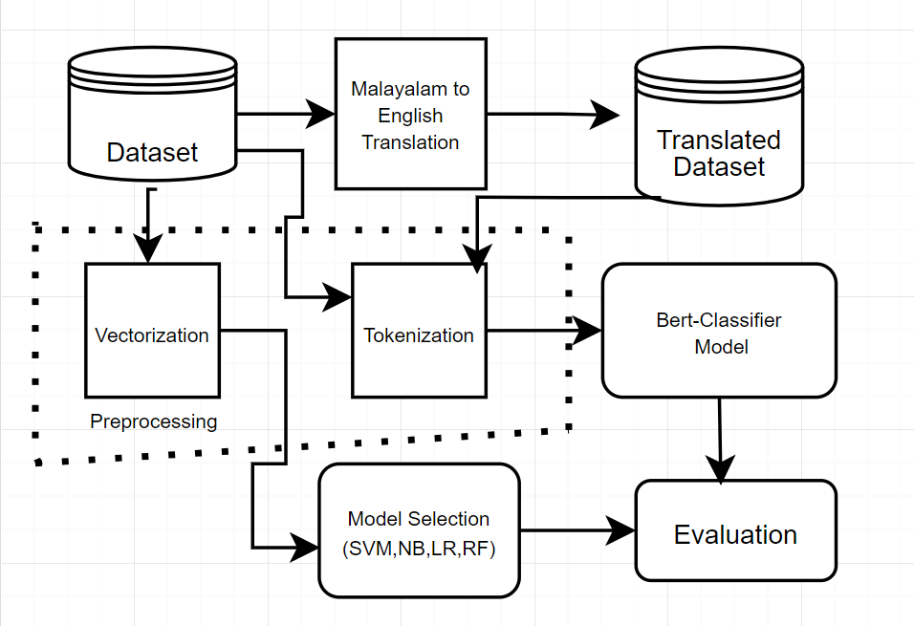
Proposed System Diagram:

Slide 8
List of modules:
Data Preprocessing
Model Selection
Machine Translation
Evaluation

Slide 9
Data Preprocessing
Vectorization for Supervised Learning:
Transform text to numerical data using TF-IDF/Count Vectorizer.
Enables language processing by machine learning models.
BERT Tokenizer:
Tokenize with BertTokenizer.from_pretrained('bert-base-uncased').
Converts words to token IDs, and handles special tokens.
Creating Tensor for BERT:
Convert token IDs to tensors for BERT model input.
Apply padding, and attention masks for variable sentence lengths.

Slide 10
Model Selection
Implemented Models: Applied four supervised learning algorithms: SVM, Logistic Regression, Naive Bayes, and Random Forest, catering to diverse decision boundaries and hypothesis spaces.
Parameter Optimization: Utilized Grid Search for each model to systematically explore a wide range of parameters and identify the optimal settings for fine-tuning model performance.
Validation and Comparison: Evaluated models based on validation scores, leveraging cross-validation techniques to ensure robustness and minimize overfitting.
Best Model Selection: The model with the highest validation score was selected as the best model, demonstrating superior predictive capability on unseen data.

Slide 11
Machine translation
Initialize Translation Pipeline: Set up with transformers' pipeline for Malayalam to English using the "Helsinki-NLP/opus-mt-ml-en" model.
Batch Processing Function: translate_texts translate lists of texts, skipping empty entries, and uses “tqdm” for progress tracking.
Translate and Append: For each text, perform translation to English and append to a list, handling empty strings appropriately.
Update DataFrame: Apply translation function to df['News'], saving results in df['translated_text'].

Slide 12
Evaluation
Accuracy Measurement: Evaluate the final model's accuracy on test data to quantify its performance in correctly predicting outcomes.
Validation Score Monitoring: Use validation scores during model training to fine-tune parameters and select the best-performing model.
Epochs: Epochs determine the number of times the learning algorithm will work through the entire training dataset, crucial for learning patterns and achieving optimal performance.

Slide 13
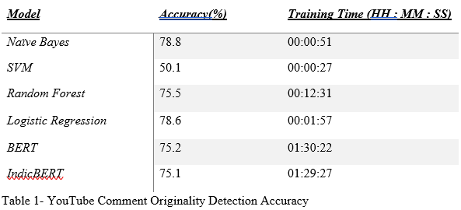
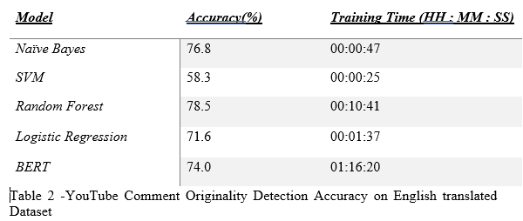
Results-Youtube Comment Originality Detection
Table 1 presents the accuracy and training times of various models applied to detect the originality of YouTube comments in Malayalam. While Naïve Bayes and logistic regression exhibit relatively high accuracies of 78.8% and 78.6% respectively, SVM and BERT show lower performance. Random Forest achieves a competitive accuracy of 75.5%.
In Table 2, the performance on an English-translated dataset is provided, where the models generally demonstrate lower accuracy compared to the Malayalam dataset, with Naïve Bayes and Random Forest performing relatively well. These results suggest the impact of language translation on the effectiveness of the models for originality detection in YouTube comments.

Slide 14
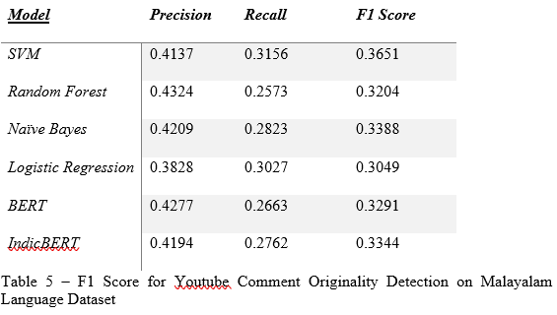
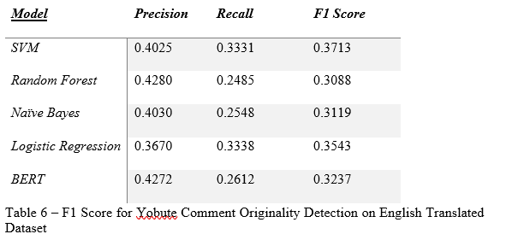
Results-Youtube Comment Originality Detection
Tables 5 and 6 show the F1 scores of different models for detecting the originality of YouTube comments in Malayalam and English translated datasets, respectively. Random Forest performs best in both cases, followed closely by Naïve Bayes. The results suggest that while certain models maintain consistent performance across languages, translation may slightly affect their effectiveness.

Slide 15
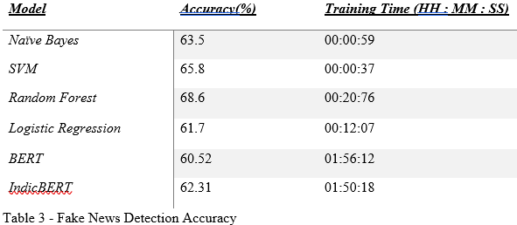
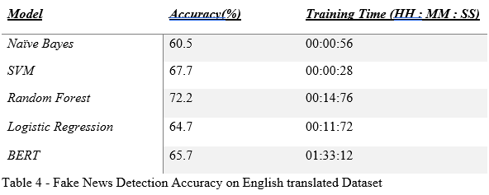
Results-Fake News Detection
Table 3 presents the accuracy and training times of various models applied to detect fake news in Malayalam. Among these models, Random Forest achieves the highest accuracy of 68.6%, followed closely by SVM with 65.8%. Naïve Bayes and IndicBERT exhibit moderate accuracies, while BERT demonstrates the lowest performance.
Table 4 shows the performance on an English-translated dataset, where Random Forest again performs the best with an accuracy of 72.2%. However, the overall performance of the models on the translated dataset is slightly lower compared to the Malayalam dataset, indicating potential challenges in cross-lingual fake news detection.

Slide 16
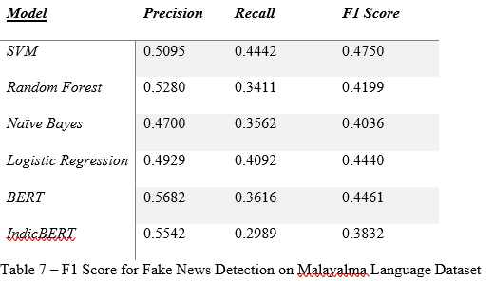
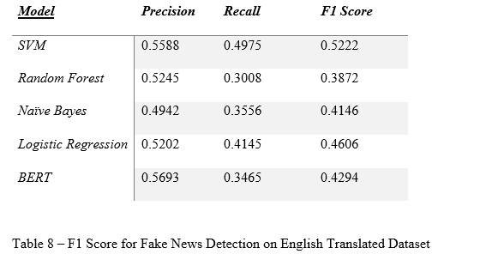
Results-Fake News Detection
Tables 7 and 8 display the F1 scores of various models for detecting fake news in Malayalam and English translated datasets, respectively. Across both datasets, SVM and Logistic Regression exhibit strong performance, with BERT also showing competitive results. However, there are variations in model effectiveness between the original and translated datasets, suggesting potential impacts of language translation on model performance.

Slide 17
Discussion
We evaluated the performance of various machine learning models on two distinct datasets: one composed of Malayalam YouTube comments aimed at distinguishing between original and fake content, and the other focusing on Malayalam news articles for fake news detection. Initially, we observed that across both datasets, models such as Naive Bayes, Random Forest, Logistic Regression, BERT, and IndicBERT exhibited competitive accuracies. However, there was a notable discrepancy when comparing the performance of the original Malayalam dataset versus the English-translated dataset.
Interestingly, upon applying the models to the English-translated dataset, we found a notable increase in accuracy for certain models, notably Naive Bayes and Random Forest, in both the YouTube comment originality and fake news detection tasks. Additionally, the training time for the translated dataset was generally reduced compared to the original Malayalam dataset. This observation suggests that while the translation process introduces linguistic variations, it may also enhance the model's ability to discern patterns in the data. Moreover, the reduced training time for the translated dataset implies that the models may require fewer computational resources to achieve comparable performance, potentially enhancing their scalability and efficiency in real-world applications.

Slide 18
Conclusion
The comparative analysis of sentiment analysis models on Malayalam datasets underscores the dominance of Naive Bayes for YouTube comment classification and Random Forest for fake news detection in terms of accuracy. Despite longer training times, BERT-based models offer deep linguistic insights, albeit not surpassing traditional models in accuracy.
A critical factor influencing performance disparities is dataset size. Deep learning models like BERT thrive on vast data, whereas the modest datasets of 3,200 comments for YouTube and 1,700 articles for news may limit their potential. Traditional models exhibit notable efficiency, possibly due to their compatibility with smaller datasets and less complex feature spaces.
The restricted dataset size emerges as a pivotal variable, potentially constraining deep learning algorithms' effectiveness. Expanding datasets or employing data augmentation strategies could enhance deep learning models' performance, leveraging their ability to grasp complex language patterns.
This research illuminates current sentiment analysis model capabilities for Malayalam texts while emphasizing the necessity for larger datasets to maximize deep learning techniques' potential. Future endeavours should focus on dataset expansion or data augmentation strategies to enhance deep learning models' performance, striking a balance between model choice, dataset size, and computational efficiency in multilingual sentiment analysis research.

Slide 19
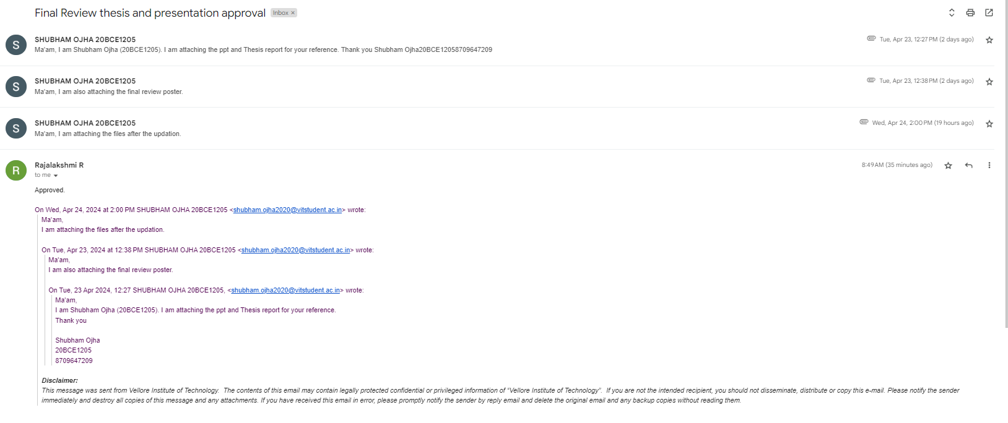
Guide Approval Mail Snapshot

Slide 20
References
Helsinki-NLP. (n.d.). opus-mt-ru-en. Hugging Face. Retrieved from https://huggingface.co/Helsinki-NLP/opus-mt-ru-en
AI4Bharat. (n.d.). indic-bert. Hugging Face. Retrieved from https://huggingface.co/ai4bharat/indic-bert
AI4Bharat. (n.d.). Indic-BERT-v1. GitHub. Retrieved from https://github.com/AI4Bharat/Indic-BERT-v1
Kakwani, D., Kunchukuttan, A., Golla, S., N.C., G., Bhattacharyya, A., Khapra, M. M., & Kumar, P. (n.d.). IndicNLPSuite: Monolingual Corpora, Evaluation Benchmarks and Pre-trained Multilingual Language Models for Indian Languages.
Yarullin, R., & Serdyukov, P. (n.d.). BERT for Sequence-to-Sequence Multi-label Text Classification.
Devlin, J., Chang, M.-W., Lee, K., & Toutanova, K. (2019). BERT: Pre-training of deep bidirectional transformers for language understanding.
Devika, K., Haripriya, B., Vigneshwar, E., Premjith, B., & Chakravarthi, B. R. (2024, March). From Dataset to Detection: A Comprehensive Approach to Combating Malayalam Fake News. In Proceedings of the Fourth Workshop on Speech, Vision, and Language Technologies for Dravidian Languages (pp. 16-23).

Slide 21
Thank you very much!

